Slide 1

3Ci
MEDICAL RESEARCH & DISCOVERY CORP
早期癌症检测的变革性技术
Company Presentation
Martin Pasek, 创始人兼首席财务官
martin@3ciresearch.com
2018年11月

Slide 2
提早发现癌症的必要性
“30-50%的癌症可以通过避免风险因素、实施预防策略，以及癌症的早期发现和早期治疗来预防。”
(世界卫生组织)
“如果早期诊断并充分治疗，许多癌症很有可能被治愈.”
(世界卫生组织)
只有30%的癌症在早期阶段被检测到
Source: https://www.cancer.net/cancer-types/oral-and-oropharyngeal-cancer/statistics

Slide 3
癌症检测的现有问题
癌症初期
无任何症状
病变
大多数可观察到的病变（异常）是良性的
活检测试
通过开刀和痛苦的方式获得组织样品
无临床观察
大多数可见的前/早期癌症看起来与普通的良性病变相同。
目前的测试方法
灵敏度不足以:
需要经验丰富的专业外科人员
广泛传播和频繁的测试太昂贵了
在最初阶段准确检测癌症
发现具有可能癌变风险的组织
“Wait and See”

Slide 4



3Ci 早期癌症检测方案
“我们的目标是在癌变前检测到癌前细胞。”
  Dr. Charles Haynes, Chief Technology Officer, 3Ci Research
正常细胞
癌前细胞
癌细胞
癌细胞的扩散
突变
突变
癌症
生物标志物
3Ci的重点是针对遗传变化的分子诊断，以识别癌前细胞
传统病理学和竞争对手的测试依赖于细胞的形态或癌症生物标志物，只能在后期检查出癌症

Slide 5
3Ci新型生物技术方法
1
3
将DNA分成片段，并用PCR技术扩增
使用三个非开刀的样本收集
口腔采样
2
分离病变DNA
唾液样本
血液样本
4
设计专有的引物和探针，在片段被照射时定向识别与癌症进展相关的DNA突变

Slide 6
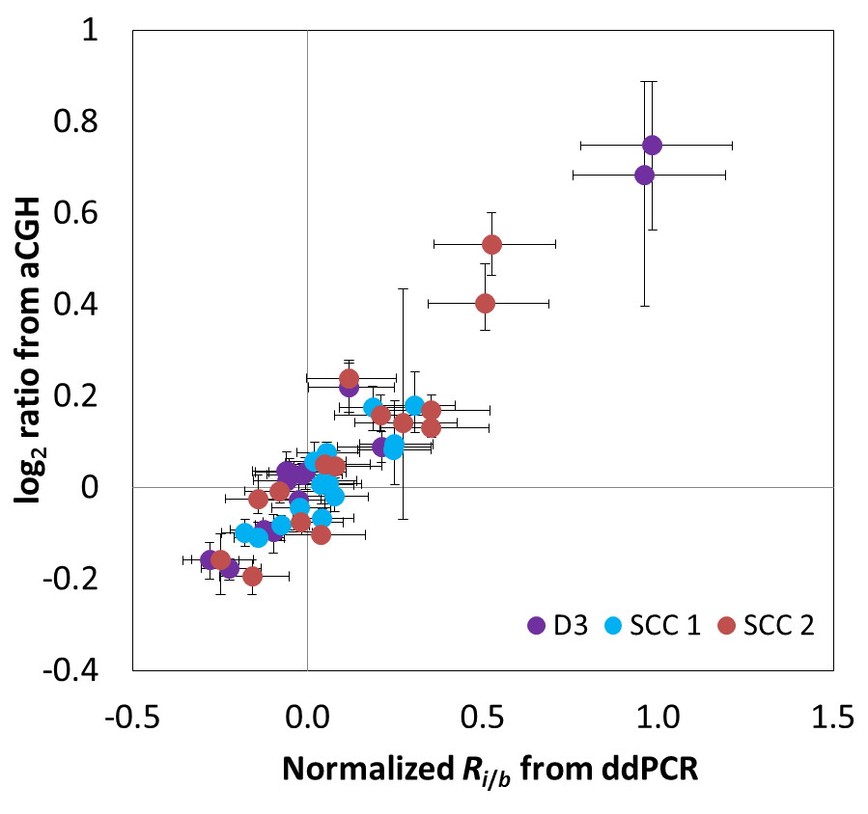
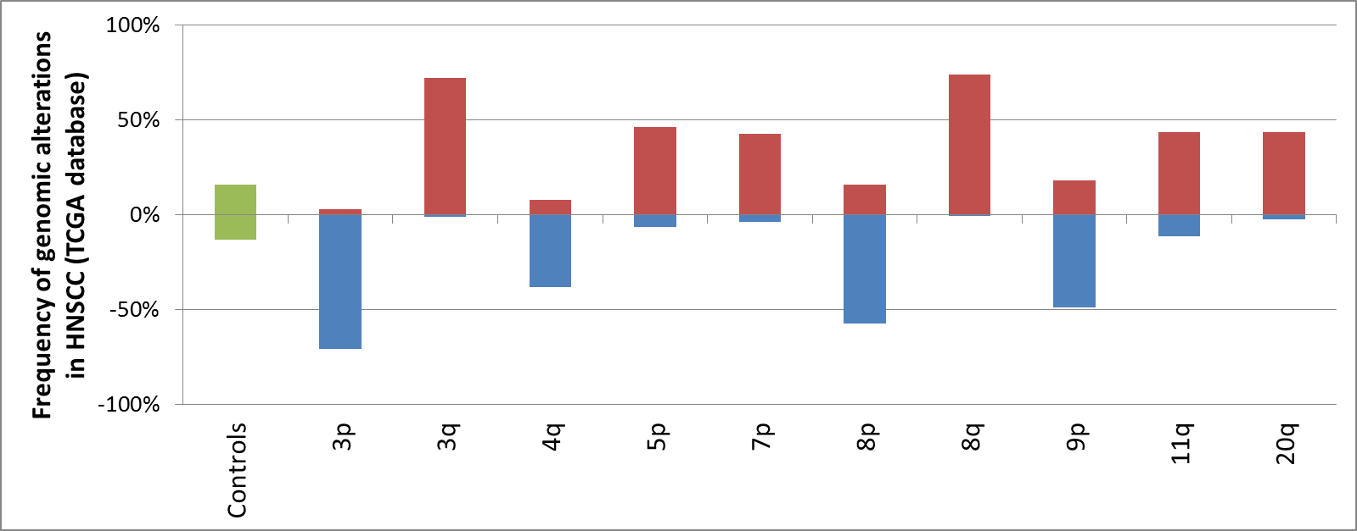
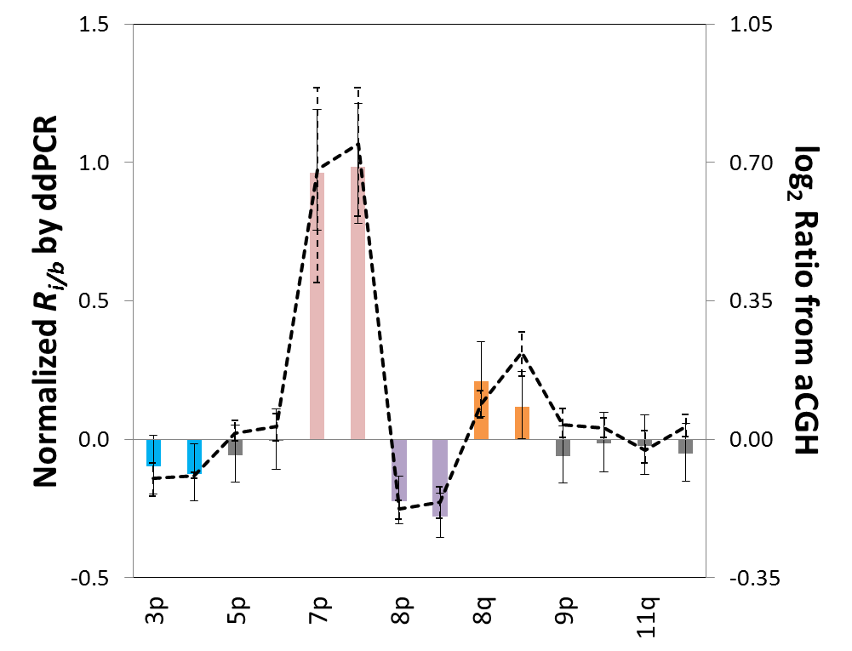
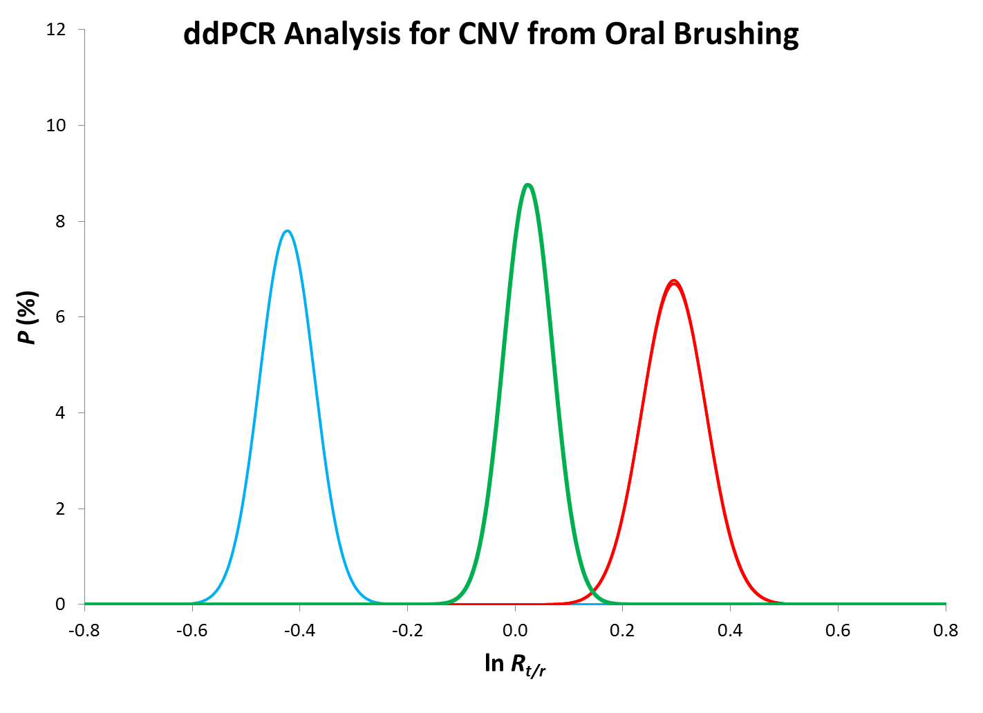
与3 Cl 生物信息学的结合
通过检测分析数据以确定病变是正常的（良性的）还是癌前的
i）成分（序列）的变异, 或
ii）通过基因组拷贝数变异来发现突变
5
正常（良性）病变模式
6
生物技术成果与3Ci的专有统计数据相结合，以确定有效性和独特开发的算法，以进而确定临床相关性。
GAINS
癌前病变模式
LOSSES
Patterns

Slide 7
3Ci 的技术价值
唯有3Ci能够 提供“Personalized Predictive Detection（个性化预测性检测）“TM
主动
测试可疑病变，以确定有癌症风险的人
准确
专注于区分正常和癌前组织
临床信息
为医疗界提供可操作的报告
高灵敏度
旨在检测癌前细胞的细微变化
在整个癌症的发展过程中:
相关的癌症条件
癌症条件
癌症中存在的和耐药性突变
= 可挽救生命的早期癌症检测
= 优化癌症治疗

Slide 8
3 Cl技术的应用
3 Cl早期检测技术平台可应用于多种癌症.
癌症
肺部
口腔
结肠
前列腺
乳腺
皮肤
黑色素瘤
非黑色素瘤
其他
HPV类癌症
颈椎
肛门
其他
口腔

Slide 9
3Ci’s 的初步诊断管道
口腔癌:
10-15％的人有口腔病变的风险，需要连续检测
口腔HPV:
14-69岁的人中1/14（2/3的人口））和1/9的男人中存在着有癌症隐患的活性的HPV
肺癌:
患者经常靶向治疗，产生耐药性，需要不断进行测试
高危人口数量
口腔病变
活性 HPV
肺癌
Global 7.5 billion
Europe 750 million
USA 320 million
Canada 32 million
China 1.35 billion
1,825,000
750 million
350 million
135 million
63 million
653,000
75 million
35 million
313,000
32 million
15 million
214,000
3 million
2 million
28,000
(Community Dent Oral Epidemiol. 2014 August)
(Annual incidence of Lung Cancer (2012) from GLOBOCAN)
(Oral Cancer Foundation, University of Florida)

Slide 10
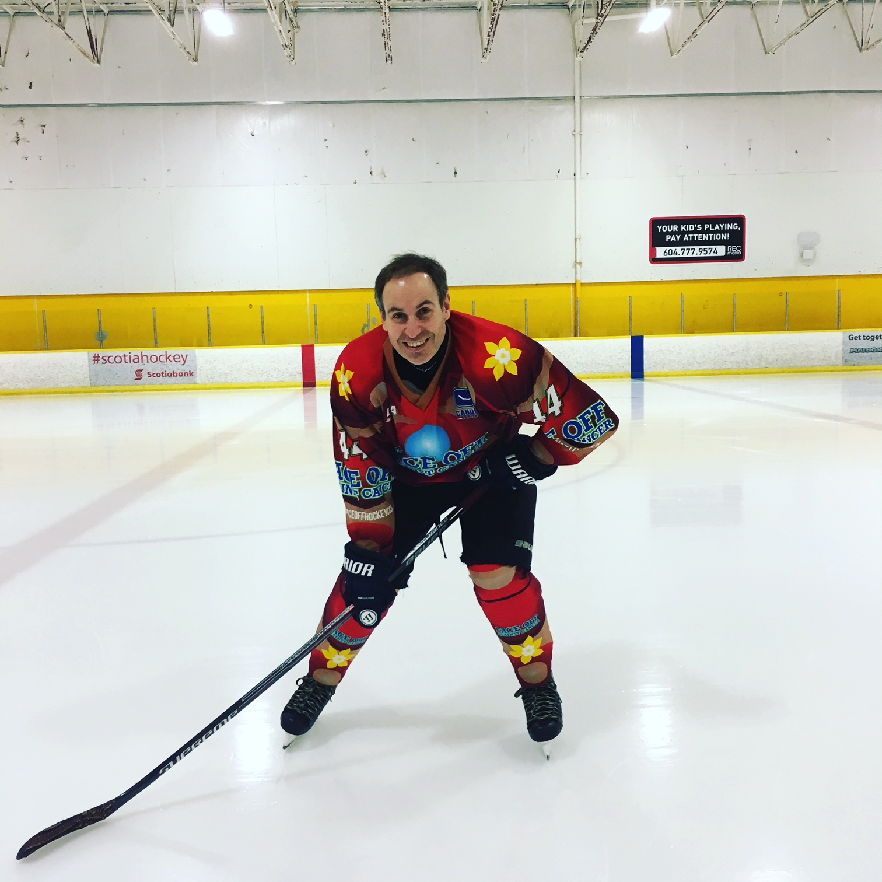

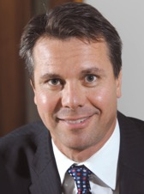
专业的创始人管理团队
Dr. Curtis Hughesman 首席科学官
科学家, Cancer Genetics and Genomic Laboratory, BC Cancer 超过10年的在BC Cancer开发用于检测与癌症进展相关的罕见基因组突变和/或指导癌症患者的治疗的临床试验的经验。
Dr. Charles Haynes 首席技术官
Michael Smith Laboratories, the Centre for Blood Research, 和UBC化学与生物工程系的界面生物技术教授和加拿大一级研究主席 .。 30年的为生产救生疗法和临床检测新工具的生物技术公司开发和商业化的经验。曾任生物技术公司联合创始人
Daniel Lewis 首席前瞻性官
拥有20年i-Group of Companies创始人的经验，发展从跨国企业到独立中小企业的商业合作伙伴关系。 曾患有头颈部癌症并治愈，从患者的角度为3Ci团队带来独特的洞察力。
Martin Pasek 首席财务官
摩根大通，CSFB和VTB Capital这类投资银行拥有20年经验。 成功商业化了许多高级技术。 Pebble Labs的联合创始人，Pebble Labs是一家早期生物技术公司，专注于通过RNAi分子修饰进行基于病毒的疾病预防。

Slide 11
3 Ci | 里程碑
3 Cl目前沿着它的既定方向发展顺利。
临床前测试完成
开始盈利
口腔癌症检测和诊断测试的临床前分析验证
10年的口腔癌患者的个人资料和结果数据的数据库
数字PCR平台技术分析开发完成
已证明的
概念
组装单分子诊断口腔癌的测试平台
申请临时专利
美国和加拿大的产品推出
全球发布
3 Cl TODAY
2006 2007 2008 2009 2010 2011 2012 2013 2014 2015 2016 2017
2018 2019 2020 2021 2022
独立临床验证完成
超过10年期间得到的恶性和非恶性口腔癌样本集合独特数据库
开发了针对分子诊断数字PCR的生物信息学
与UBC和BC Cancer合作研究协议
生物标志物鉴定区分癌性/非癌细胞
预计FDA 510（k）许可

Slide 12
3Ci |非稀释性资金
1580万美元的非稀释性资本已用于研究。
我们正在筹集250万加元的知识产权普通股，用于进一步的临床前开发，临床验证，扩展应用和企业发展。
3Ci TODAY
12-18 个月
$0.5
million
匹配非稀释性
$2.5 million
融资
Jan
2017
先前的用于科研的非稀释性资金
$15.8 million
先前的用于科研的非稀释性资金

Slide 13
3Ci |为什么现在投资
3Ci首次提供股权，这是一次显著降低风险的投资生物技术的机会
▼技术风险
已被证实的概念 能够应用于检测各种癌症的平台技术
▼监管风险
FDA 510(K) 一类比FDA申请容易些 产品只需做FDA的声明，不需要做申报拿证
▼商业化风险
在24个月内确定可开始盈利 可规模化扩展的增长 合作伙伴/许可技术的更高的可能性

Slide 14
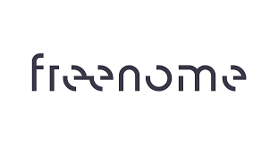

3Ci |估值和退出潜力
基于最近与使用创新技术检测癌症的类似公司的市场交易，3Ci有望实现重大价值和退出机会
估值: $1.75 billion via $250 million funding round in 2017 |  | 估值: >$5 billion via $300 million Series C funding in 2018 |  | 估值: >$500 m estimate implied from $78 million raised over 3 rounds in 4 years |  | 估值: >$3 billion estimate implied from $550 million raised over 7 rounds in 6 years
遗传唾液检测试剂盒，用于确定与疾病相关的遗传性状 |  | 用于早期检测的“液体”（血液）遗传癌检测 |  | “液体”活检诊断平台检测癌症的无细胞DNA测序 |  | “液体”活检对DNA进行数字测序，以确定癌症检测和治疗方案。
投资者: Genetech (Roche), Pfizer, Johnson & Johnson, Google |  | 投资者: Bezos, Gates, Illumina, Johnson & Johnson, Sequoia Capital |  | 投资者: Andreessen Horowitz, Founders Fund, Google Ventures, Polaris |  | 投资者: Khosla Ventures, Sequoia Capital, Lightspeed, Softbank, Temasek

Slide 15
3Ci | 免责声明
The information contained in this investor presentation is for information purposes only and is not intended to constitute an offering of securities. Certain statements constitute forward-looking information under applicable securities law. Readers are cautioned that such information is expressly subject to our Forward Looking Statements Disclaimer.
Information contained in this investor presentation was accurate at the time of posting, but may be updated, amended or superseded by subsequent disclosures, or may become outdated and inaccurate over time. Changes will be updated as soon as possible.
Forward Looking Statements Disclaimer
This investor presentation contains certain information regarding 3Ci Medical Research and Discovery Corp. (“the Company”) that may constitute forward-looking information under applicable securities law. Forward looking statements are used to provide potential investors in the Company with information regarding the Company including management’ s assessment of its future financial and operational plans and outlook. The words ‘ anticipate’ , ‘ expect’ , ‘ believe’ , ‘ may’ , ‘ should’ , ‘ will’ , ‘ estimate’ , ‘ project’ , ‘ outlook’ , ‘ forecast’ or other similar words are used to identify such forward-looking information and statements. Disclosure related to expected revenue rates, equipment utilization or operating activity levels, operating costs, capital expenditures and other guidance provided throughout this investor presentation constitutes forward-looking statements. These forward-looking statements were based upon various underlying factors and assumptions, including current research information and scientific analysis in particular; the Company’ s business prospects and opportunities; and estimates of the financial and operational performance of the Company and are not guarantees of future performance.
Forward-looking information and statements are subject to known or unknown risks and uncertainties that may cause actual results to differ materially from those anticipated or implied in the forward-looking information and statements. Risk factors that could cause actual results or events to differ materially from current expectations include, but are not limited to:
(1) the ability of the Company to successfully implement its scientific research and product development strategy and whether these will yield the expected benefits;
(2) competitive factors in the medical and pharmaceutical industry;
(3) the success or failure of product development programs;
(4) currently existing applicable laws and regulations or future applicable laws and regulations that may affect the Company’ s business;
(5) decisions of regulatory authorities and the timing thereof
(6) the economic circumstances surrounding the Company's business, including general economic conditions in Canada, the US and worldwide;
(7) changes in exchange rates; and
(8) claims or concerns regarding the safety or efficacy of marketed products or product candidates.
Unpredictable or unknown factors not discussed in this Cautionary Disclaimer could also have material adverse effects on forward-looking statements.
Readers are cautioned not to place undue reliance on forward-looking statements as there can be no assurance that the plans, intentions or expectations upon which they are placed will occur. Such forward looking statements, although considered reasonable by management as of the date hereof, may prove to be incorrect and actual results may differ materially from those anticipated. Forward-looking statements contained in this investor presentation are expressly qualified by this cautionary statement. Furthermore, any forward looking statements contained in this investor presentation are accurate only as of the date such statements were made or as of the date of this investor presentation. The Company does not undertake any obligation to update publicly or to revise any of the included forward-looking statements, whether as a result of new information, future events or otherwise, except as expressly required by securities law.

